Slide 1

INTERNSHIP REPORT FOR WEEK 3
MITRE ENGAGE
GOAL : AFFECT
-ARUN ASHOK BADRI

Slide 2
MITRE ENGAGE AND IMPLEMENTATION OF AFFECT GOAL USING HONEYPOTS
INTERNSHIP REPORT PLAN
Month 1: Orientation and Goal Selection
Month 2: Proposal and Planning
Month 3: Implementation and Documentation

Slide 3

MITRE ENGAGE
MITRE Engage is a knowledge base developed by the MITRE corporation, initially known as MITRE Shield. It provides ACTIVE DEFENSE information based on years of adversary engagement experience
To help work with the data, MITRE provides mappings that organize views. It includes a mapping between Engage and the MITRE ATT&CK® framework.
It was released in order to stimulate conversations about adversary engagement and ACTIVE DEFENSE, as well as ways in which defenders can employ active defense.

Slide 4
ENGAGE MATRIX
The Engage Matrix is broken into several components,
1. Prepare(Strategic action) -- Strategic actions ensure that defenders appropriately drive operations with strategic planning and analysis. These actions map to the Prepare and Understand phases of the 10-Step Process.
2. Expose, Affect and Elicit (Engagement action) -- Engagement actions are the traditional cyber denial and deception activities that are used to drive progress towards your objectives. These actions map to the Operate phase of the 10-Step Process.
3. Understand (S﻿trategic action)-- Strategic actions ﻿ensure that defenders appropriately drive operations with strategic planning and analysis. These actions map to the Prepare and Understand phases of the 10-Step Process.

Slide 5
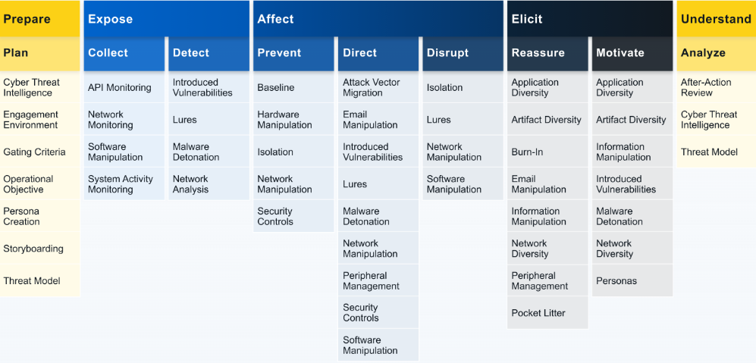
ENGAGE MATRIX

Slide 6
LET‘S DISCUSS ABOUT -
AFFECT ID: EGO0002 Negatively impact the adversaries operations.
Affect is ultimately about changing the cost-value proposition in cyber operations for the adversary.
For example, the defender can negatively impact the adversary’s on-network operations to drive up the resource cost of doing operations by slowing down or selectively resetting connections to impact exfiltration.
Goal: increase operational costs and decrease the value of collected data

Slide 7
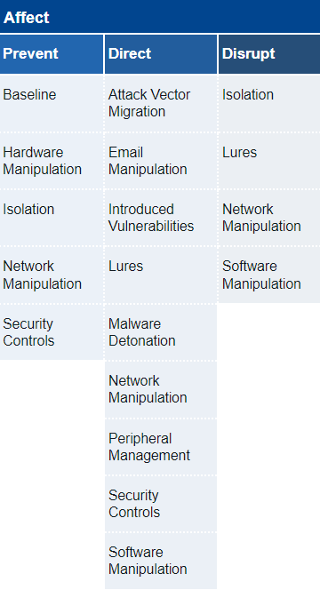
ENGAGEMENT GOAL : AFFECT
Engage defines three approaches to make progress towards the Affect goal.
Prevent, focuses on setting up mitigations that stop some portion of an adversary’s operation’s from even starting.
Direct, attempts to maneuver an adversary into a better position for the defender.
Disrupt, seeks to cause problems in an adversary’s operations.

Slide 8
1.PREVENT
PREVENT
ID: EAP0003
Stop all or part of the adversary’s ability to conduct their operation as intended.
The defender can physically or virtually remove or disable resources, tighten security controls, or otherwise impair the adversary’s ability to operate
Additionally, a defender can use prevention activities to discourage the adversary from operating against a specific target.
ENGAGE uses a combination of Denial, Deception, and Adversary Engagement technologies to Affect the Adversary

Slide 9
TECHNIQUES USED IN ‘PREVENT’ APPROACH
BASELINE : Identify key system elements to establish a baseline and be prepared to reset a system to that baseline when necessary.
HARDWARE MANIPULATION: Alter the hardware configuration of a system to limit what an adversary can do with the device.
Eg: physically removing a system’s microphone, camera, on-board Wi-Fi adapter, etc

Slide 10
TECHNIQUES USED IN ‘PREVENT’ APPROACH
ISOLATION: Configure devices, systems, networks, etc. to contain activity and data, thus preventing the expansion of an engagement beyond desired limits.
NETWORK MANIPULATION: Make changes to network properties and functions to achieve a desired effect.
Eg: throttle network speeds, segment the network, maintain a unique IP addressing scheme, add a kill switch to cut off network access, etc.
SECURITY CONTROLS: Alter security controls to make the system more or less vulnerable to attack.
Eg: Enable/Disable Autorun, Configure Firewalls, modifying Group Policies

Slide 11
2. DIRECT
DIRECT ID: EAP0004
Encourage or discourage the adversary from conducting their operation as intended.
Direction activities focus on moving the adversary towards or away from an intended path. This forced direction can be accomplished by removing or disabling some resources, while adding or enabling others.
the defender can tighten some security controls while leaving others overly permissive or weakened
GOAL: the defender hopes to force the adversary to take unintended actions or stop intended actions.

Slide 12
TECHNIQUES USED IN ‘DIRECT’ APPROACH
ATTACK VECTOR MIGRATION: Move a malicious link, file, or device from its intended location to an engagement system or network for execution/use.
PERIPHERAL MANAGEMENT: Manage peripheral devices used on systems within the network for engagement purposes.
Eg: the defender may include data on a connected USB device or stage an important conversation near an externally connected camera or microphone
EMAIL MANIPULATION: Modify the flow of email in the environment.

Slide 13
TECHNIQUES USED IN ‘DIRECT’ APPROACH
LURES: Deceptive systems and artifacts intended to serve as decoys, breadcrumbs, or bait to elicit a specific response from the adversary.
Eg: Lures can take a variety of forms including credentials, accounts, files/directories, browser extensions/bookmarks, system processes, etc.
MALWARE DETONATION: Execute malware under controlled conditions to analyze its functionality.
NETWORK MANIPULATION: Make changes to network properties and functions to achieve a desired effect. (Also used in Prevent approach)

Slide 14
3. DISRUPT
DISRUPT ID: EAP0005
Impair an adversary’s ability to conduct their operation as intended.
Disruption activities are used to stop or discourage an adversary from conducting part or all of their mission
This disruption may increase the time, skills, or resources needed for the adversary to accomplish a specific task
Eg: a defender may degrade network speeds as the adversary attempts to exfiltrate large blocks of data.

Slide 15
TECHNIQUES USED IN ‘DISRUPT’ APPROACH
SOFTWARE MANIPULATION: Make changes to a system’s software properties and functions to achieve a desired effect.
Eg: For example, the defender could show all files when viewed in a graphical application but hide files or introduce decoy files when viewed via a terminal command.
ISOLATION:
LURES:
NETWORK MANIPULATION:

Slide 16
ELASTICSEARCH/ Kibana
Elasticsearch is a powerful, open-source search and analytics engine that is used for a wide range of data analysis and search applications.
It is a part of the Elastic Stack, which includes tools like Logstash and Kibana.

Slide 17
Key features and use cases of Elasticsearch & Kibana:
Real-Time Data Analysis: ideal for monitoring and analyzing log and event data, as well as other time-series data.
Analytical Capabilities: powerful analytical features, including aggregations, geospatial search, and machine learning capabilities through the Elastic Stack.

Slide 18
Key features and use cases of Elasticsearch & Kibana:
Log and Event Data: commonly used for log and event data analysis, often in conjunction with Logstash (for data collection) and Kibana (for data visualization and dashboarding).
Monitoring and Alerting: used to monitor the health and performance of your cluster(Servers that are being monitored), and you can set up alerts based on predefined conditions.

Slide 19
Different ways to run Elasticsearch & Kibana
Using Docker: We can use the Docker desktop to integrate kibana and elasticsearch and run
Using Localhost: We can install both the Tools and set them up and then run them locally
Using Elastic Cloud: Developed by Elasticsearch itself and very fast and efficient to use

Slide 20

Installation & Setup
Download the .zip archive for Elasticsearch 8.10.2 from: https://artifacts.elastic.co/downloads/elasticsearch/elasticsearch-8.10.2-windows-x86_64.zip
Unzip the archive and save it to the desktop
Open Powershell as Administrator
This command generates a password to be used to login to the localhost.
in our case the host is https://140.113.110.115:9200/
cd C:\Users\user\Desktop\elasticsearch-8.10.2
\bin\elasticsearch.bat

Slide 21
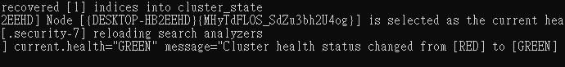

The output snippet of the command \bin\elasticsearch.bat is given below.
The status of the cluster is now green.
Green indicates that the Cluster is running successfully and now we can login and access the dashboard

Slide 22
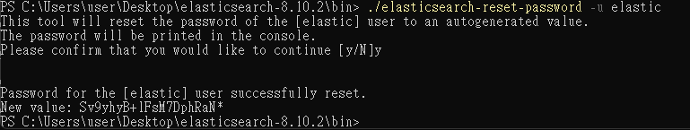
If the password is not available in the console, We can reset the password using the command below.
./elasticsearch-reset-password -u elastic
the password in my case is highlighted in red border in the above image

Slide 23
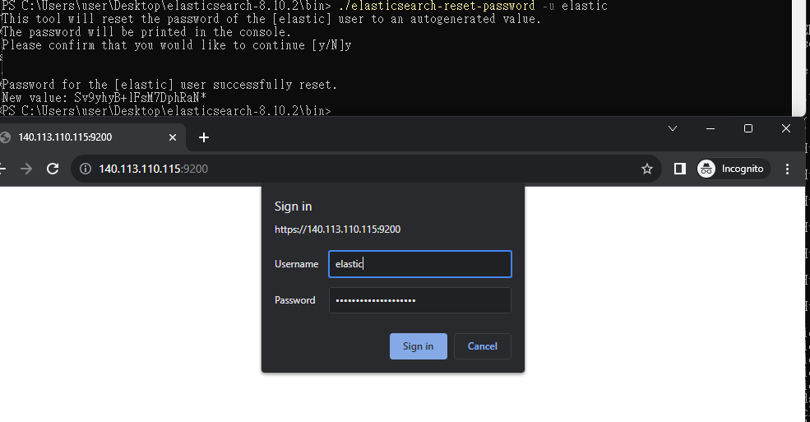

Slide 24
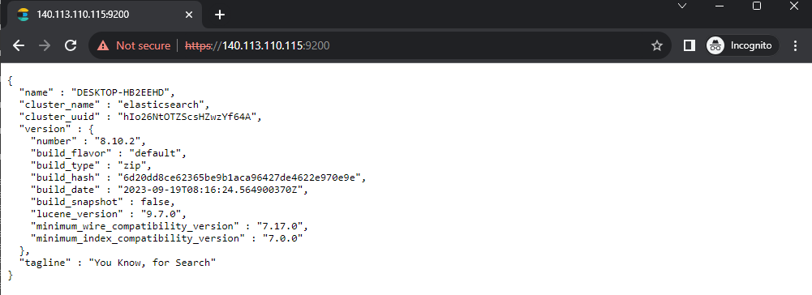
Successful Login

Slide 25
Setting up Kibana
Download the .zip archive for Kibana from the official elasticsearch website
Unzip the archive and save it to the desktop
Open Powershell as Administrator
cd C:\Users\user\Desktop\kibana-version
\bin\kibana.bat

Slide 26
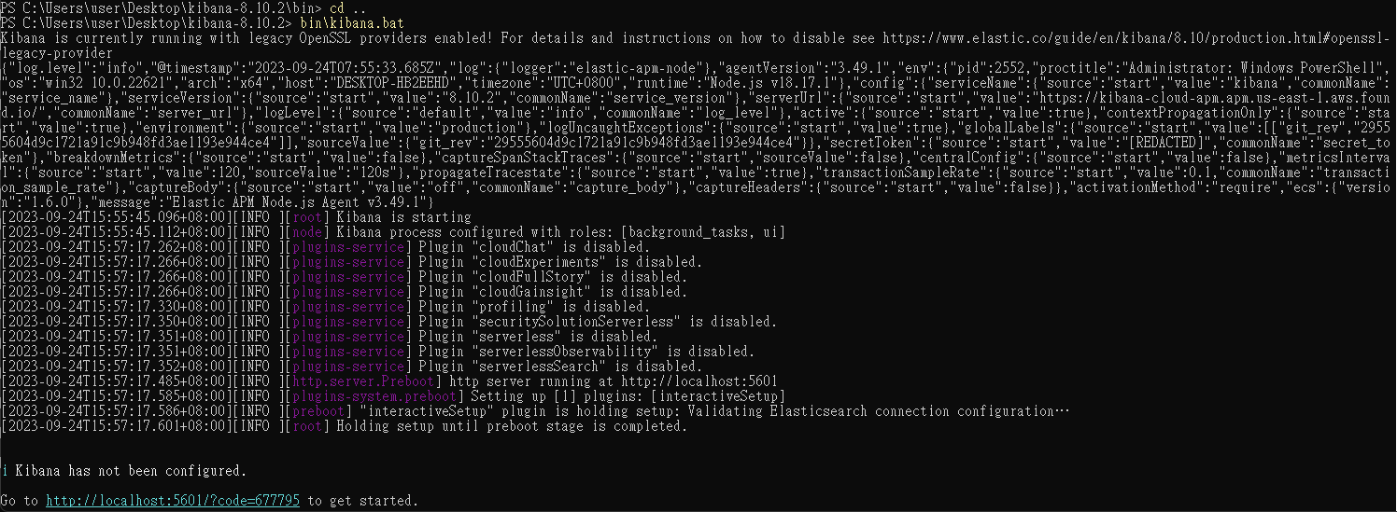
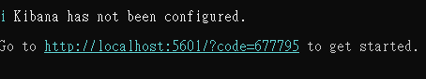

The output snippet of the command \bin\kibana.bat is given below.

Slide 27
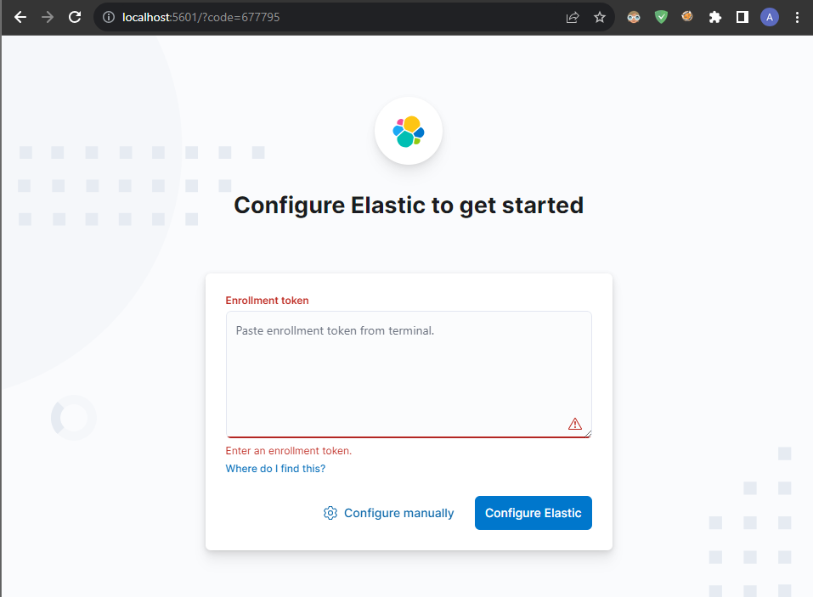
After opening the given url i.e.”http://localhost:5601/?code=677795”
We need to give the enrollment token generated using the command down below in the elasticsearch directory
bin\elasticsearch-create-enrollment-token.bat --scope kibana

Slide 28
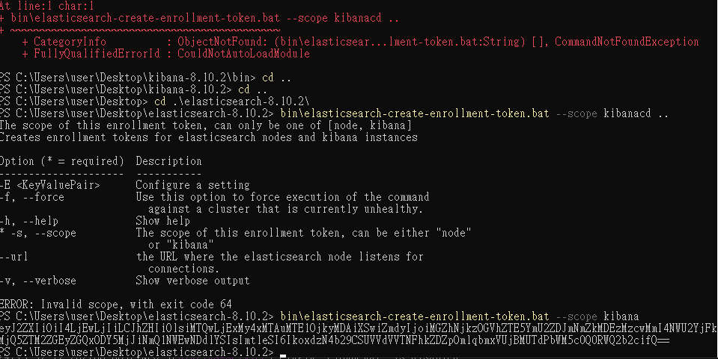

Slide 29
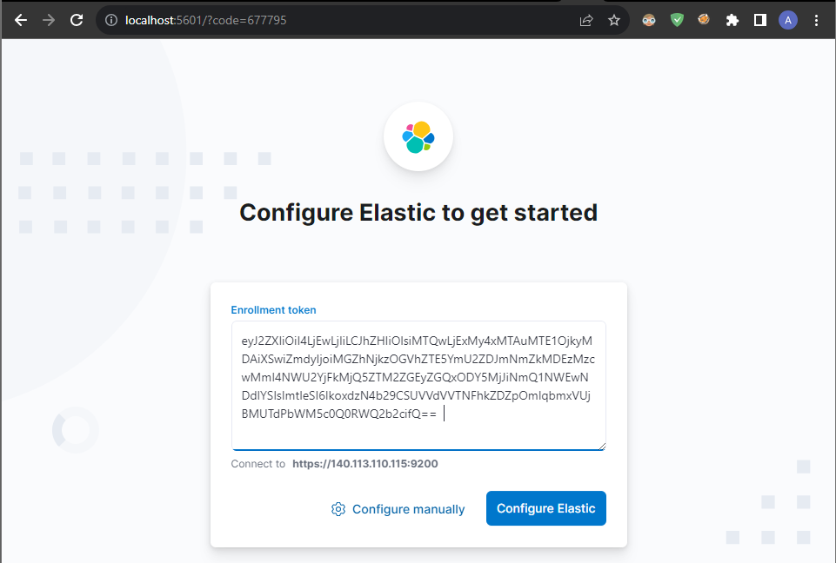

Slide 30
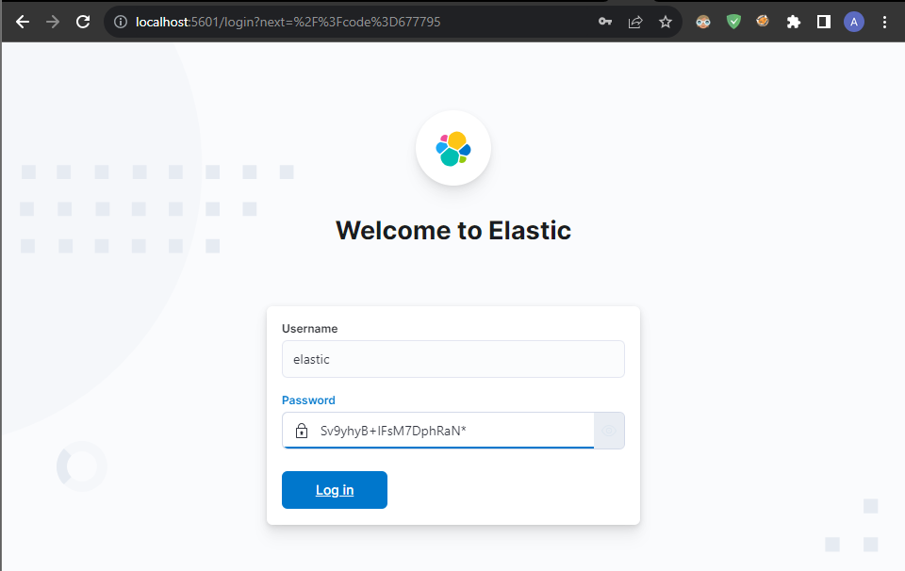
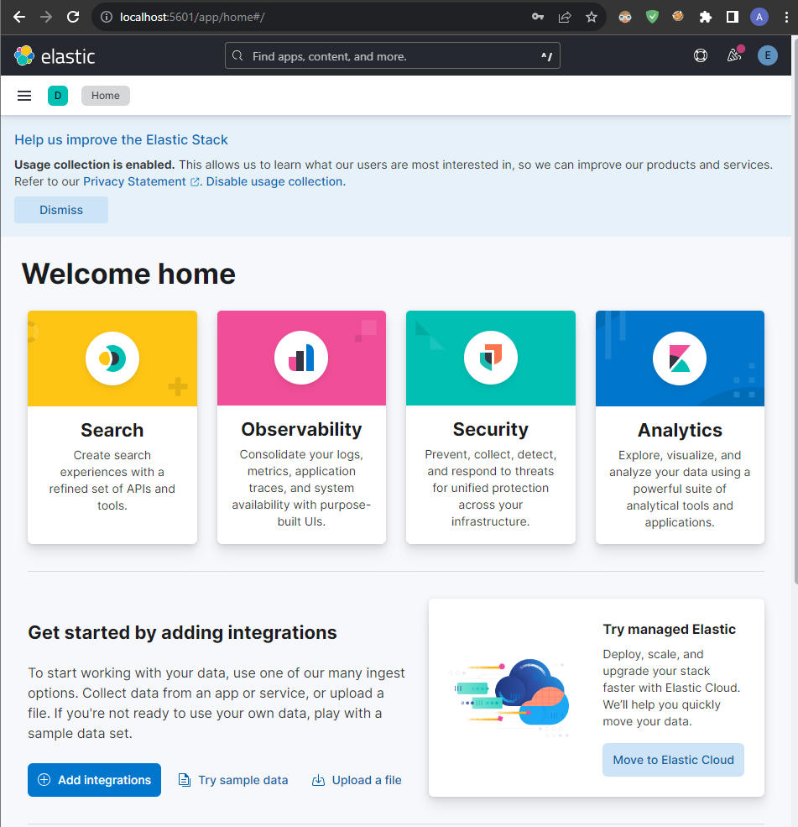


Slide 31
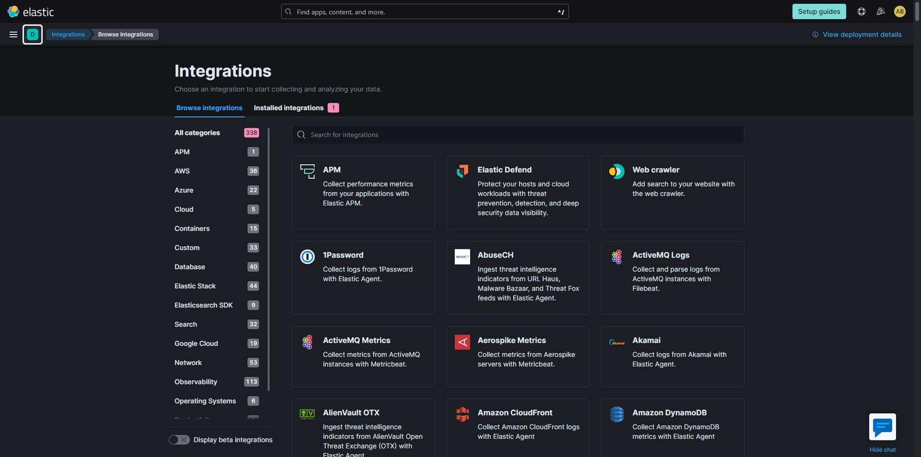
Working and Usage of the Elasticsearch Dashboard

Slide 32
Demonstration of the working of the Elasticsearch & Kibana Dashboard

Slide 33
Elastic Security for SIEM & security analytics
Security information and event management, SIEM for short, is a solution that helps organizations detect, analyze, and respond to security threats before they harm business operations.
Elasticsearch can be integrated with various tools and services to achieve Secure Workspace and environment.

Slide 34
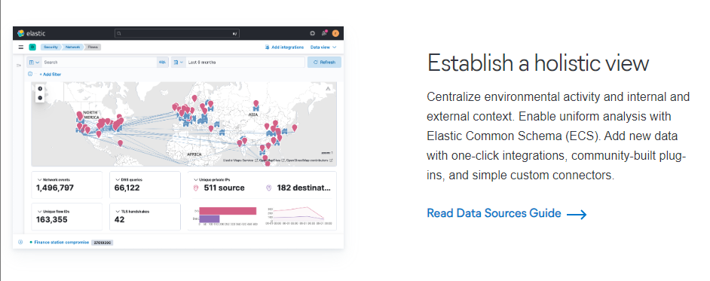
ElasticSearch + SIEM Analytical Capabilities

Slide 35
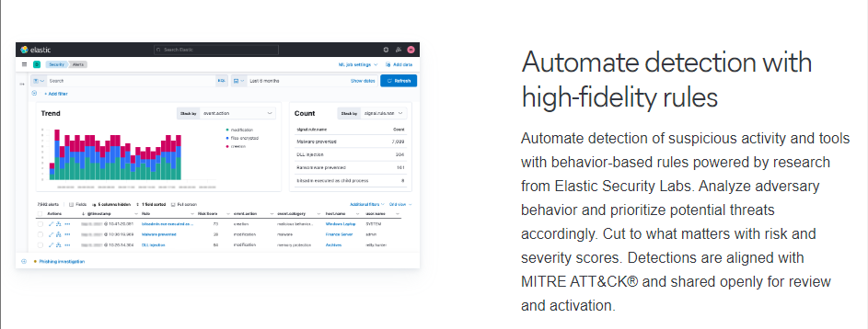
ElasticSearch + SIEM Analytical Capabilities

Slide 36
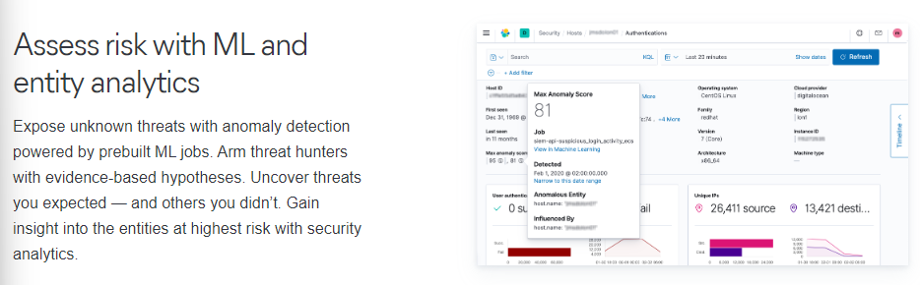
ElasticSearch + SIEM Analytical Capabilities

Slide 37
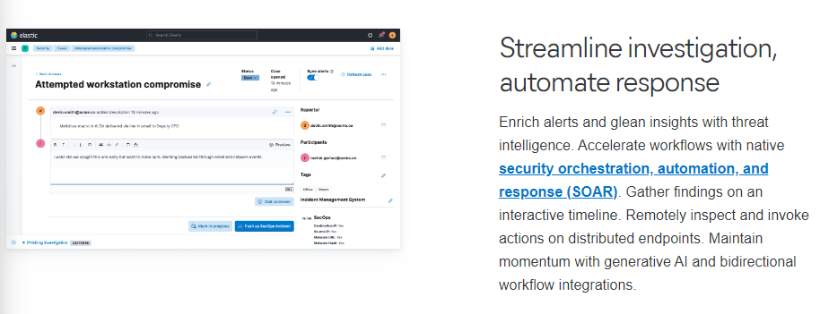
ElasticSearch + SIEM Analytical Capabilities

Slide 38
Real world demonstration of
Elasticsearch & Kibana
Explanation of the Scenario:
Attacker (workstation) tries to DDOS a small server (Virtual machine)
Attacker IP: 140.113.110.115
Virtual Machine IP: 192.168.98.129
DDOS by PING command (Windows Powershell)
Command used to ping --> 1..1000000 | ForEach-Object { Test-Connection -Count 1 -ComputerName 192.168.98.129 }
The above command will send 1 Million PIng Packets to the Server

Slide 39
Live Demonstration of the Attack and the Detection by the Elasticsearch & Kibana Integration

Slide 40
Any Questions..?

Slide 41
Thank
you!

